Slide 1
Project 1 - Inventory of Steel Rods

Slide 2
Contents
Topic research
Business & data understanding
Exploratory data analysis (EDA) before data cleaning/preparation
Data cleaning/Preparation
Exploratory data analysis (EDA) after data cleaning/preparation
Saving of cleaned & processed data
Notes:
Change

Slide 3
Project Overview and Scope
Inventory of Steel Rods:
The business is facing a problem of underutilizing the offcuts steel rods, which are eventually sold as scrap at a loss of revenue. This inefficient use of resources is negatively impacting the company's profitability.
Objectives:
Minimize the underutilization of offcuts rods.
Maximize the profitability.
Goals:
It could help to reduce the underutilization the offcuts of steel rods by at least 35%.
Minimize the manual calculations of using inventory.

Slide 4
Business Problem
The underutilized offcuts of steel rods, which are eventually sold as scrap at a loss of revenue, is negatively impacting the company's profitability.

Slide 5
Objectives
Constraints
Minimize underutilization.
Maximize profitability.
Maximize manual calculations in inventory use.
Lack of inventory usage planning and organization.

Slide 6
CRISP-ML(Q) Methodology
Business Understanding and Data Understanding
Data Preparation
Model Building
Evaluation
Model Deployment
Monitoring and Maintenance

Slide 7
Technical Stacks
Programming Language:
Python 3.11.5 (Spyder 5.4.3)
IPython 8.15.0
Data Manipulation Libraries:
Pandas
NumPy
Data Visualization Libraries:
Matplotlib
Seaborn
Statistical Analysis Library:
Scipy (“stats” module)
Automated Exploratory Data Analysis (Auto-EDA) Libraries:
SweetViz

Slide 8
Technical Stacks
Python Standard Library:
“os” module
Machine Learning Library:
scikit-learn (SimpleImputer, LabelEncoder & RobustScaler classes)
Feature Engineering Library:
feature_engine (“transformation” module & “Winsorizer” class from “feature_engine.outliers” module)
Others:
Microsoft Office 2021
Microsoft Edge
Google Chrome
Chat GPT

Slide 9
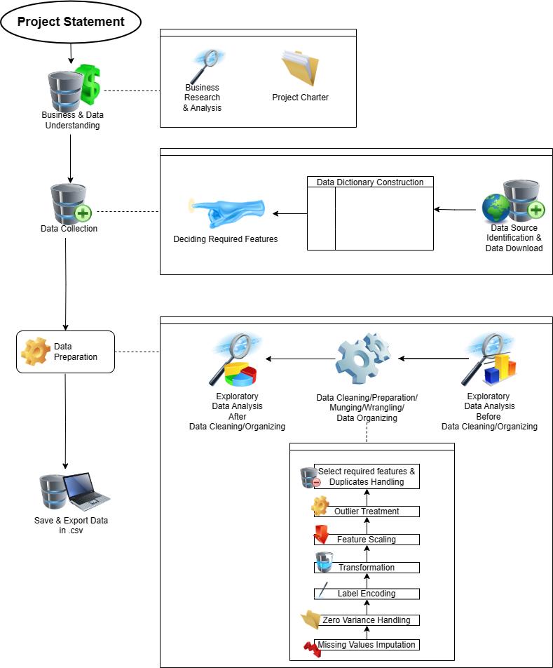
Project Architecture

Slide 10
Data Collection and Understanding
Column Name | Description | Data-Type
Date | The specific day, month, and year on which the order or supply of TMT rods was made. | Datetime
FY | Financial Year | Object
Customer Name | The party that has entered into a contract for the supply or manufacture of TMT rods. | Object
Dia | The thickness of the TMT rod, measured in millimeters. | Object
Dia Group | Assorted set of different length of rods | Object
Grade | The quality level of the TMT rod, indicating its strength and durability. | Object
Type | The category of TMT rods, such as construction or industrial use. | Object
Length | The size of the TMT rod, measured in meters. | Object
Quantity | The amount of TMT rods ordered or supplied, measured in metric tonnes. | Float
Rate | The cost of the TMT rods per metric tonne. | Float

Slide 11
System Requirements
Device Requirements:
Processor 12th Gen Intel(R) Core(TM) i3-1215U 1.20 GHz
Installed RAM 8.00 GB (7.69 GB usable)
Storage Device 256GB M.2 PCIe NVMe Solid State Drive
System type 64-bit operating system, x64-based processor
Windows Requirements:
Edition Windows 11 Home Single Language
Version 22H2
Installed on ‎6/‎18/‎2023
OS build 22621.2428
Experience Windows Feature Experience Pack 1000.22674.1000.0

Slide 12
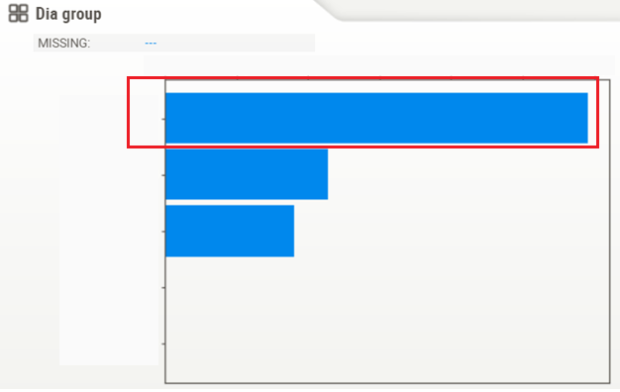
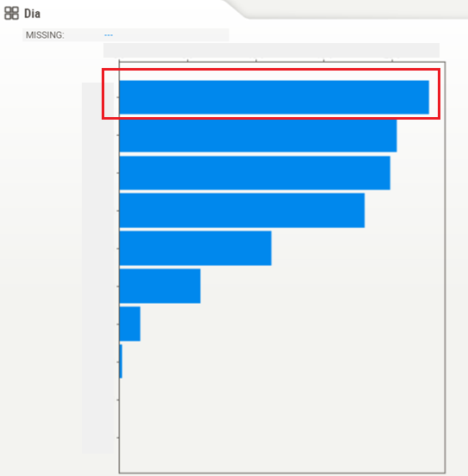
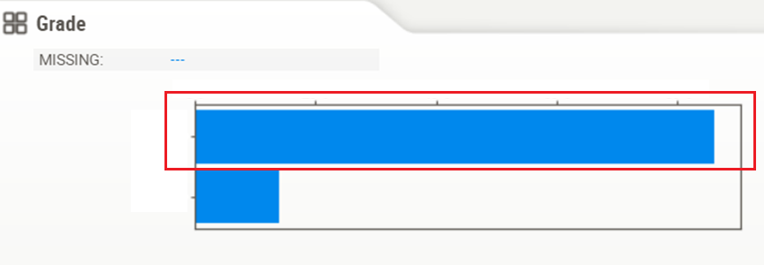
Exploratory Data Analysis [EDA]
Selected features: ‘Dia’, ‘Dia group’, ‘Grade’, ‘Quantity’, ‘Rate’
First business decision moment, the Mode:
1) ‘Dia’:
2) ‘Dia group’:
3) ‘Grade’:
Notes:
EDA is used for seeing what the data can tell us before the modeling task.
Change

Slide 13
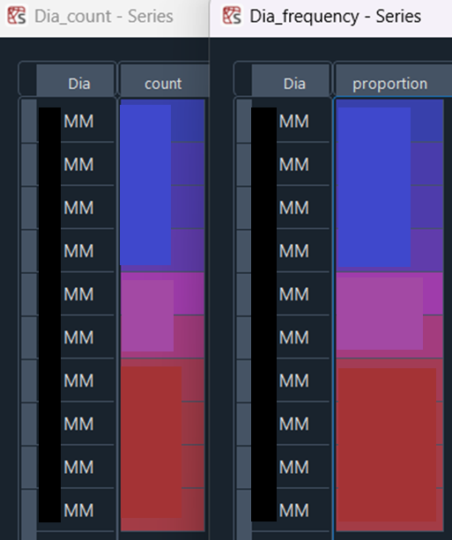
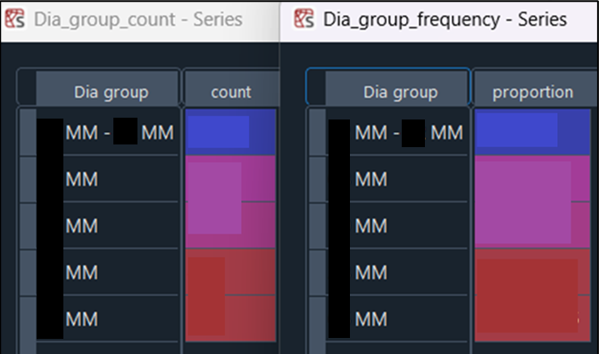
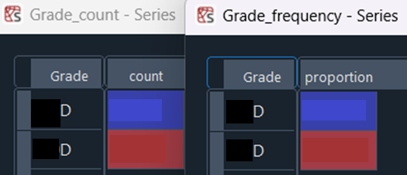
Exploratory Data Analysis [EDA]
1) ‘Dia’ count & frequency (in %):
2) ‘Dia group’ count & frequency (in %):
3) ‘Grade’ count & frequency (in %):
Notes:
EDA is used for seeing what the data can tell us before the modeling task.
Change

Slide 14
Exploratory Data Analysis [EDA]
Inferences:
The most popular types of TMT rods which have received the maximum numbers of orders are: Xmm in thickness, with assorted set of thickness in Ymm - Zmm, and WD in grade.
Except for thickness ('Dia' feature), the difference in popularity among the most preferred and less preferred options in terms of quality level ('Grade’) and assorted set of different thickness ('Dia group') are more than & about 50% respectively.
Notes:
EDA is used for seeing what the data can tell us before the modeling task.
Change

Slide 15
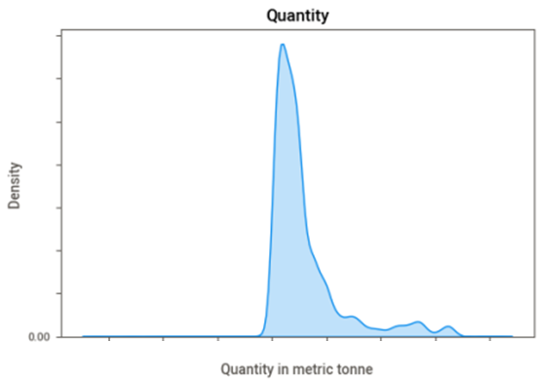
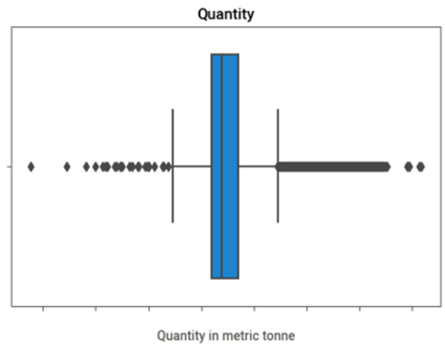
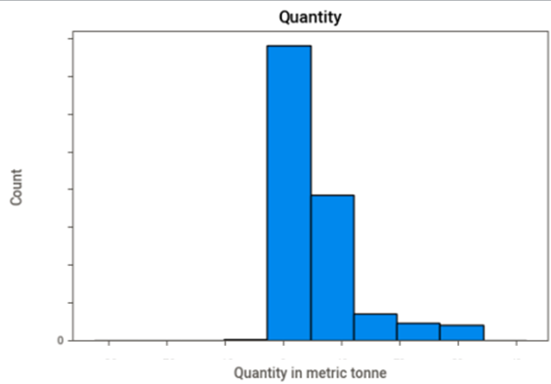
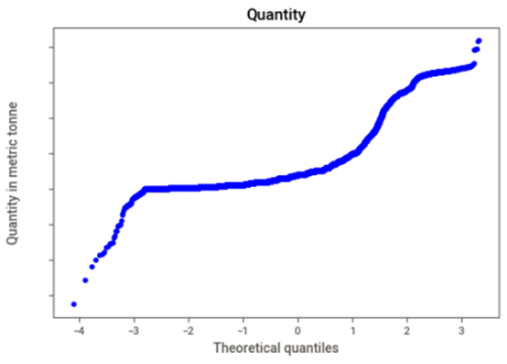
Exploratory Data Analysis [EDA]
4) ‘Quantity’ business decision moments:
# 1st:
Mean =
Mode =
Median =
# 2nd:
Variance =
Standard deviation =
Range =
# 3rd: Skewness =
# 4th: Kurtosis =
Notes:
EDA is used for seeing what the data can tell us before the modeling task.
Change

Slide 16
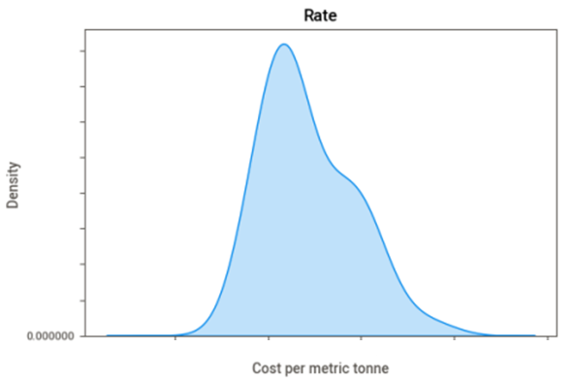
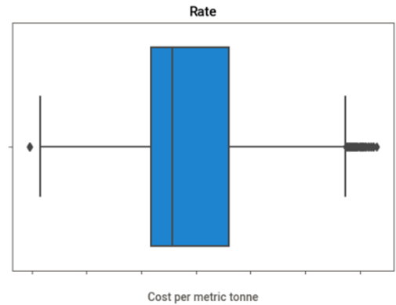
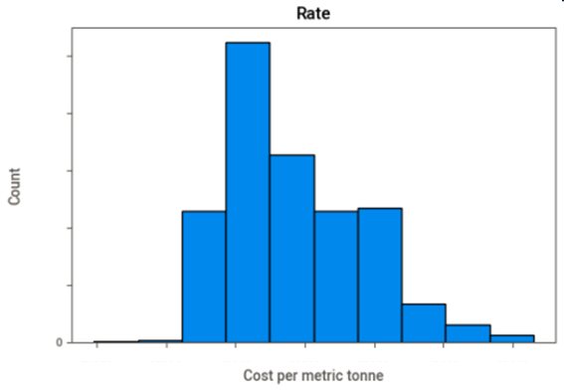
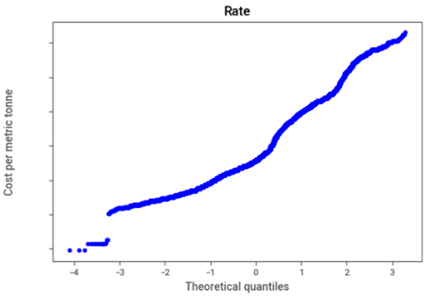
Exploratory Data Analysis [EDA]
5) ‘Rate’ business decision moments:
# 1st:
Mean =
Mode =
Median =
# 2nd:
Variance =
Standard deviation =
Range =
# 3rd: Skewness =
# 4th: Kurtosis =
Notes:
EDA is used for seeing what the data can tell us before the modeling task.
Change

Slide 17
Exploratory Data Analysis [EDA]
Inferences:
Both ‘Quantity’ and ‘Rate’ features are having outliers, but there are more outliers in 'Quantity’.
Both features are right skewed, which means high frequencies at lower order quantity side with cheaper charging cost for TMT rods are more common.
As a larger standard deviation indicates greater variability or dispersion of data points from the mean, therefore the costs of TMT rods per metric tonne are greatly deviated from its mean compared to the order quantity in metric tonne, as standard deviation of 'Rate’ and 'Quantity' are X & Y respectively.
For both ‘Quantity’ and ‘Rate’, theoretical quantiles for data normality test are not showing up on the x-axis of Q-Q plots as expected, which potentially due to the presence of missing values in the raw dataset.
Notes:
EDA is used for seeing what the data can tell us before the modeling task.
Change

Slide 18
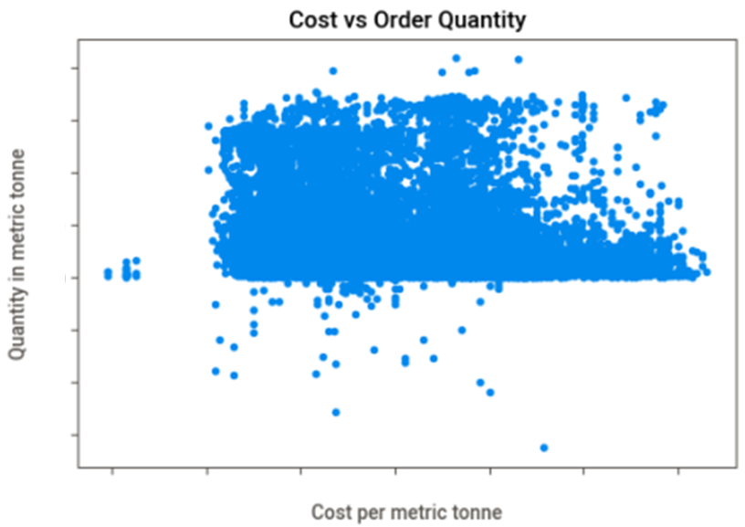
Exploratory Data Analysis [EDA]
Relationship between 'Rate' & 'Quantity' with scatter plot:
x-axis = ‘Rate’, y-axis = ‘Quantity’
From the scatter plot, a big tight cluster & outliers both exist.
Cluster: Tight cluster suggests there is a strong some kind of positive relationship between cost per metric tonne and quantity ordered in metric tonne, which means cheaper cost is resulting in a more orders.
Outliers: Suggests the presence of outliers in both features.
Notes:
EDA is used for seeing what the data can tell us before the modeling task.
Change

Slide 19
Exploratory Data Analysis [EDA]
EDA Conclusion:
As there are outliers, potential missing values, data distribution skewness, non-numeric categorical and unnecessary features present in the dataset, a subsequential data cleaning & organizing is needed.
Notes:
EDA is used for seeing what the data can tell us before the modeling task.
Change

Slide 20
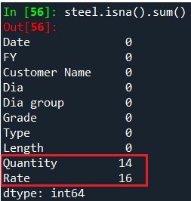
Missing Values Observation
In EDA, as theoretical quantiles (the red diagonal line) is missing from Q-Q plots for both ‘Quantity’ and ‘Rate’ numeric features, which is a potential sign of missing values, a further investigation on the raw dataset is needed:
Inferences:
In raw dataset, there are 14 missing values in ‘Quantity’, and 16 in the ‘Rate’.
As it is essential to maintain data integrity, accuracy and reliability, missing values was addressed first in data cleaning/preparation process. This was to avoid any potential strange outcomes along the process, at the same time allowed a meaningful analysis and interpretation in data.
In the EDA scatter plot of "Cost vs Order Quantity’’, 'Quantity' & 'Rate’ are somehow strong positively correlated, having outliers and are positively skewed.
Hence, median imputation was used for both, as median is a more representative measure of central tendency than the mean in this case due to the presence of skewness.
Data pre-processing steps: Median imputation, check/remove zero variance, label encoding, Yeo-Johnson transformation, robust scaling, IQR winsorized outliers, select required features and remove duplicates.

Slide 21

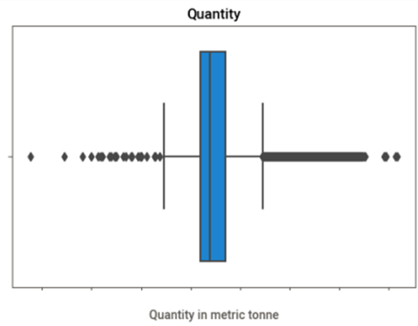
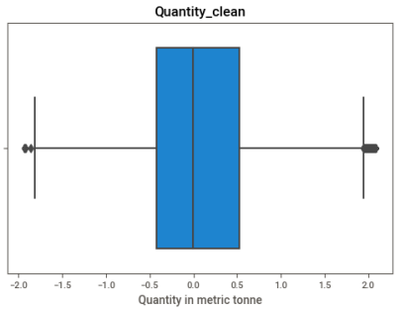
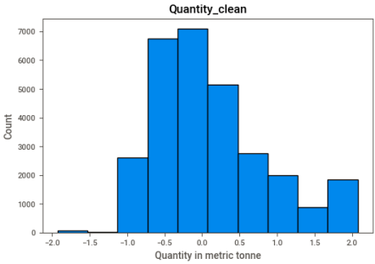
Data Visualization
After data cleaning/Preparation/Munging/Wrangling/Data Organizing:
1) ‘Quantity’ business decision moments: (Figure in red = before data cleaning/preparation)
# 1st:
Mean = 0.12 ( )
Mode = 2.07 ( )
Median = -0.002 ( )
# 2nd:
Variance = 0.58 ( )
Standard deviation = 0.76 ( )
Range = 4.0 ( )
# 3rd: Skewness = 0.88 ( )
# 4th: Kurtosis = 0.32 ( )
Notes:
EDA is used for seeing what the data can tell us before the modeling task.
Change

Slide 22
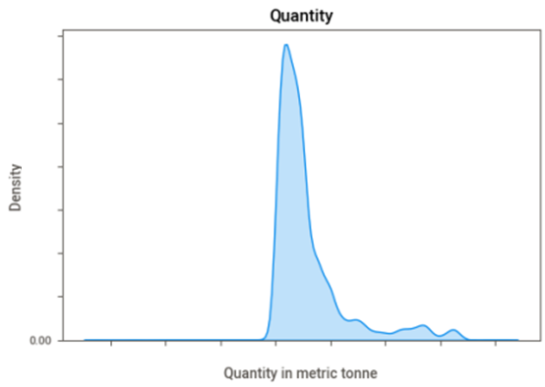
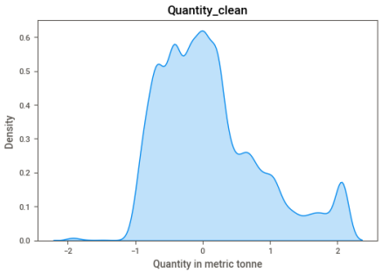
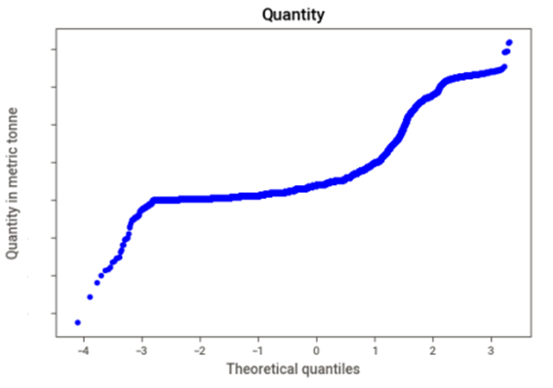
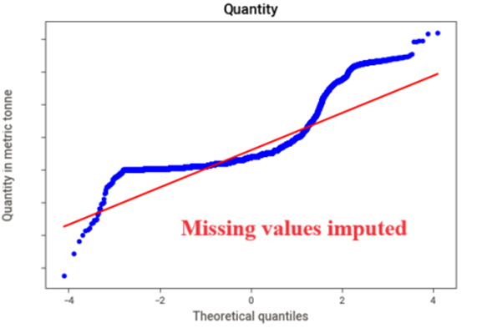
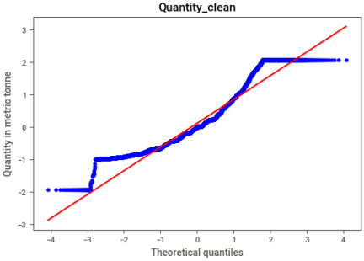
Data Visualization
Notes:
Piee

Slide 23

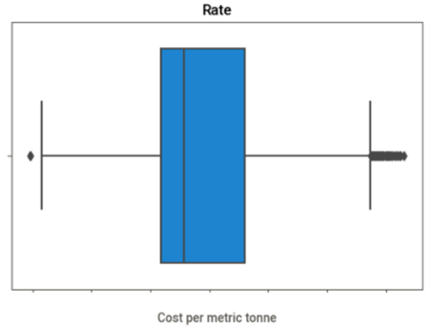
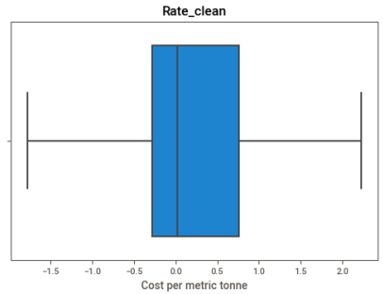
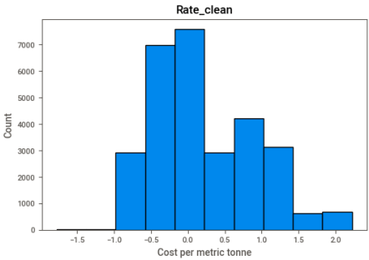
Data Visualization
2) ‘Rate’ business decision moments: (Figure in red = before data cleaning/preparation)
# 1st:
Mean = 0.22 ( )
Mode = -0.12 ( )
Median = 0.02 ( )
# 2nd:
Variance = 0.47 ( )
Standard deviation = 0.69 ( )
Range = 4.0 ( )
# 3rd: Skewness = 0.64 ( )
# 4th: Kurtosis = -0.26 ( )
Notes:
EDA is used for seeing what the data can tell us before the modeling task.
Change

Slide 24
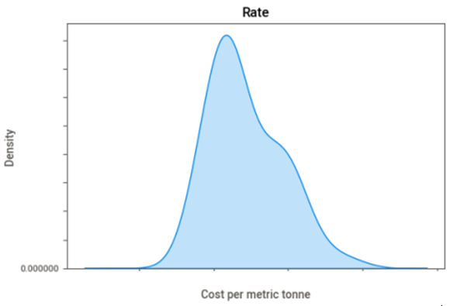
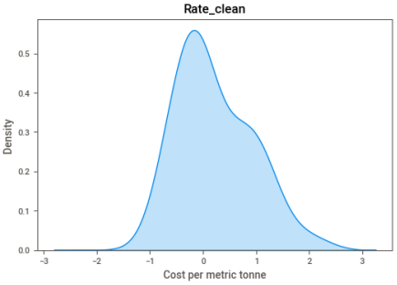
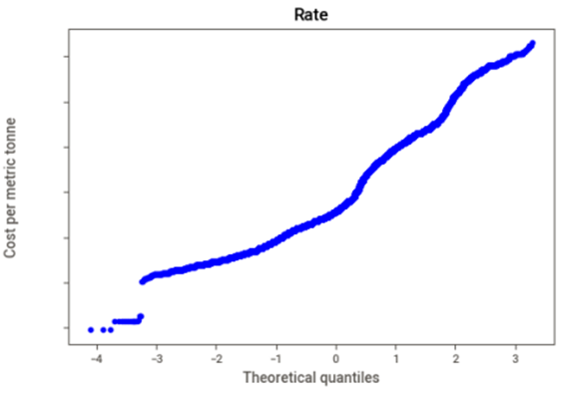
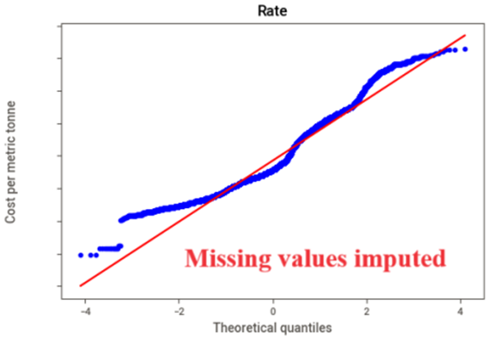
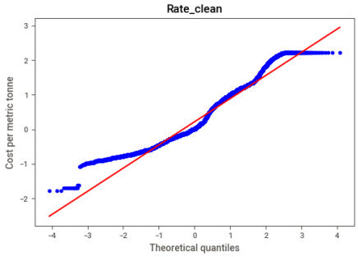
Data Visualization
Notes:
Piee

Slide 25
Data Visualization
Inferences:
From boxplots, after data pre-processing, there is no visible outliers in 'Rate', but there are visible outliers in 'Quantity’ which is much fewer, which potentially due to an excessive presence of outliers in the raw 'Quantity’ data.
For ‘Quantity’, based on histograms and density plots, after data pre-processing, there is a significant improvement in data distribution skewness (much fewer extreme data points), which is confirmed by the much smaller skewness reading (3rd moment). For ‘Rate’ feature, there is a slightly improvement in the same.
For 'Quantity’, based on Q-Q plots, after data pre-processing there is a significant improvement in data distribution normality (data points follow theoretical quantiles closer in Q-Q plot), which is confirmed by the closer to zero kurtosis reading (4th moment). For ‘Rate’ feature, as indicated by the reduced kurtosis reading after data pre-processing, there are lesser extreme values and flatter peak than the normal distribution.
In conclusion, after pre-processed, data are less skewed and are closer to normal distribution.
Notes:
Piee

Slide 26

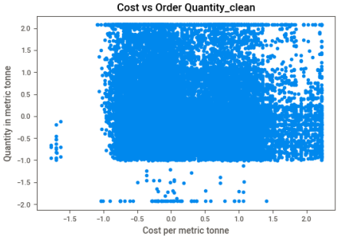
Data Visualization
Relationship between processed 'Rate' & 'Quantity':
Inferences:
The strong some kind of positive relationship between cost per metric tonne and quantity ordered in metric tonne, which means cheaper cost is resulting in a more orders, is remain the same after data cleaning/preparation process.
Notes:
Piee

Slide 27
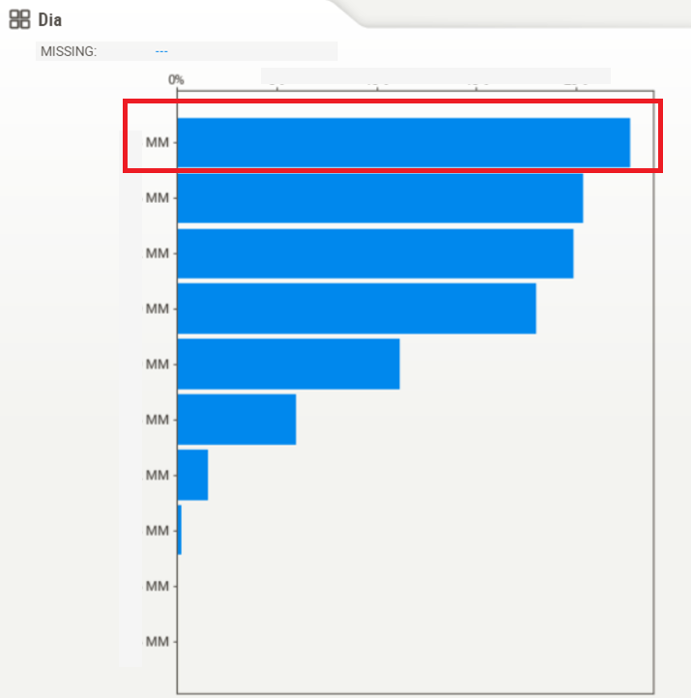
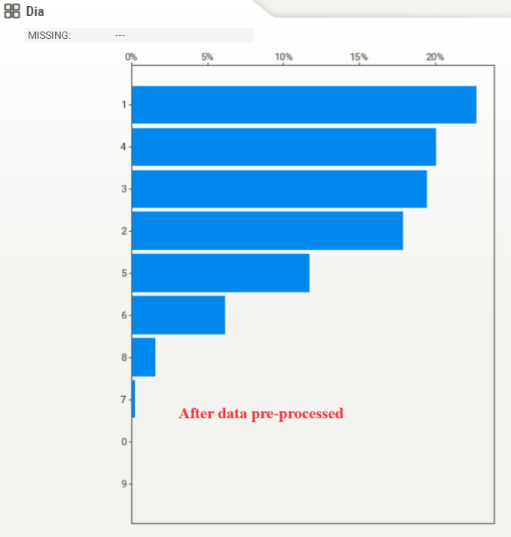
Data Visualization
Bar charts comparison for ‘Dia’:
Notes:
EDA is used for seeing what the data can tell us before the modeling task.
Change

Slide 28
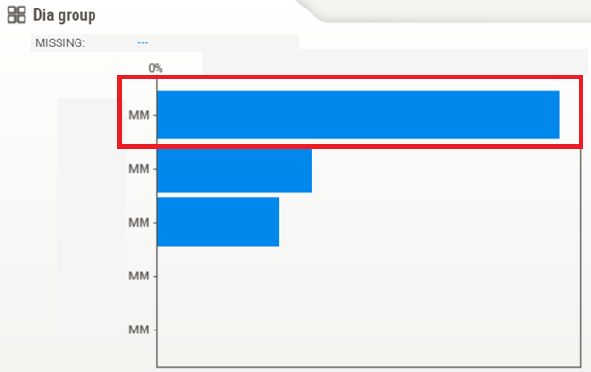
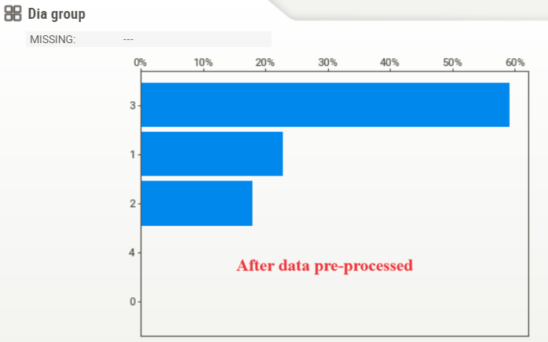

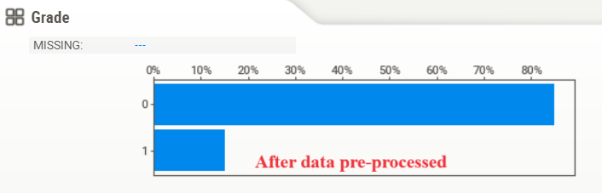
Data Visualization
Bar charts comparison for ‘Dia group’ and ‘Grade’:
Inference: Non-numeric ordinal features in the dataset have been encoded into numeric with order preservation.
Notes:
classification is the task of predicting a discrete class label. Regression is the task of predicting a continuous quantity.
What is classification techniques in machine learning?
The Classification algorithm is a Supervised Learning technique that is used to identify the category of new observations on the basis of training data. In Classification, a program learns from the given dataset or observations and then classifies new observation into several classes or groups.
What is regression techniques in machine learning?
Regression is a technique for investigating the relationship between independent variables or features and a dependent variable or outcome. It's used as a method for predictive modeling in machine learning, in which an algorithm is used to predict continuous outcomes.

Slide 29
Future Scopes
The most popular types of TMT rods which have received the maximum numbers of orders are: Xmm in thickness, with assorted set of thickness in Ymm - Zmm, and WD in grade. Hence, future product quality and characteristics improvement R&D in existing TMT rods products may focus on these specifications. Besides, new innovative types of TMT rods product can also be developed based on these specifications.
As the mode of ‘Rate’ before data cleaning/preparation process is x, which means the cost of x per metric tonne is seems to be the most acceptable price level by customers in general for a specific category of TMT rods, costing and future product price determination may take this specific price level as a reference for gaining the maximum possible profit margin.

Slide 30


